Slide 1
YOLOv5 Object Detection
Janibyek Bolatkhan
CSE’2025

Slide 2

Introduction
Autonomous Driving

Slide 3
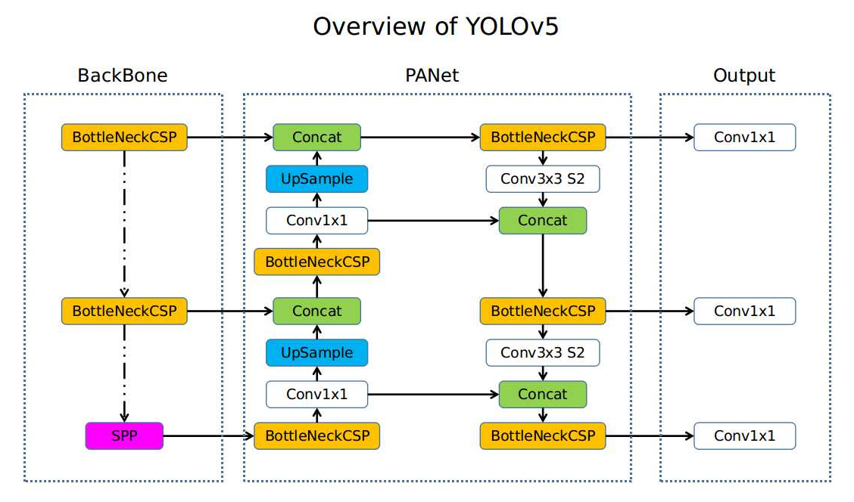
YOLO
“You only look once” object detection algorithm
Developed by Ultralytics

Slide 4
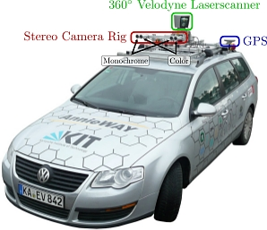
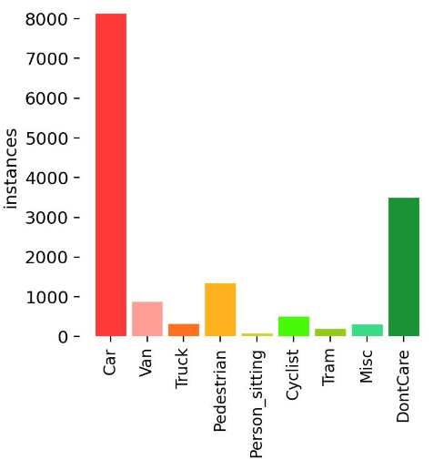
KITTI Dataset
Karlsruhe Institute of Technology
Captured around the city of Karlsruhe, rural
Consists of 7481 training images
Number of class 10

Slide 5
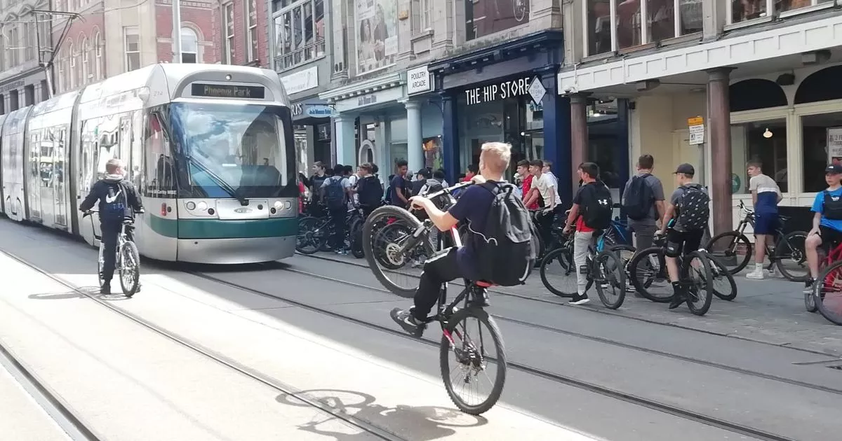
Advantages of KITTI Dataset
Classes
Documentation
Annotations for classes
Image Quality

Slide 6
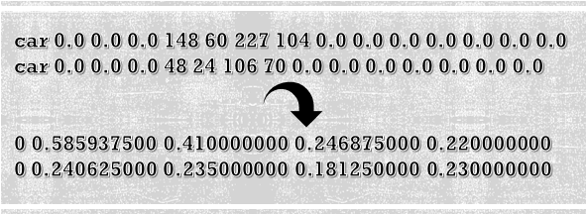
Inconveniences of KITTI Dataset
Incompatibility
Memory Issues
Half dataset, 80-20-20 method
KITTI to YOLO format

Slide 7
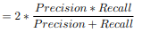
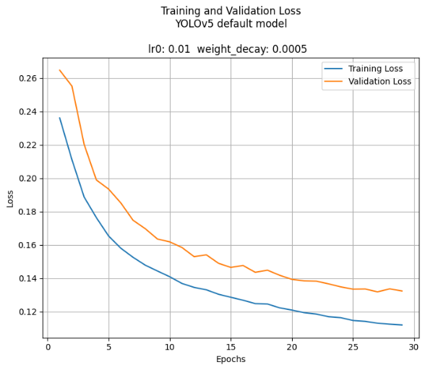
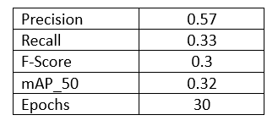
Evaluation
Metrics:
Classification: Precision, Recall, F-Score
Detection Metrics: mAP (Mean Average Precision)
Overfit Mitigation

Slide 8
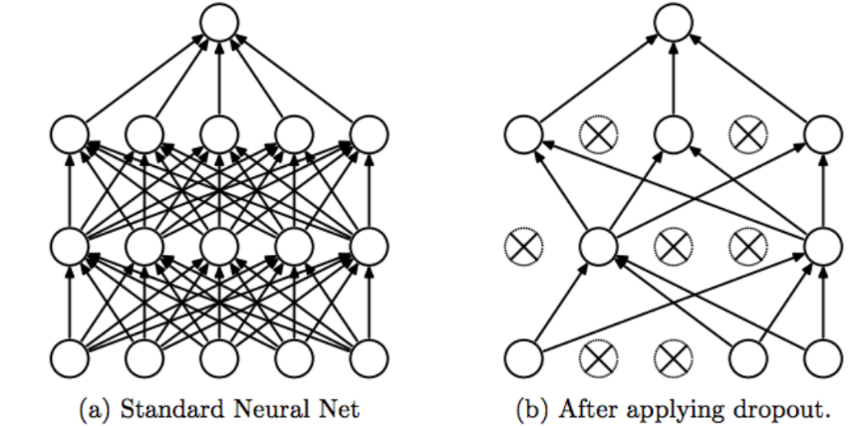
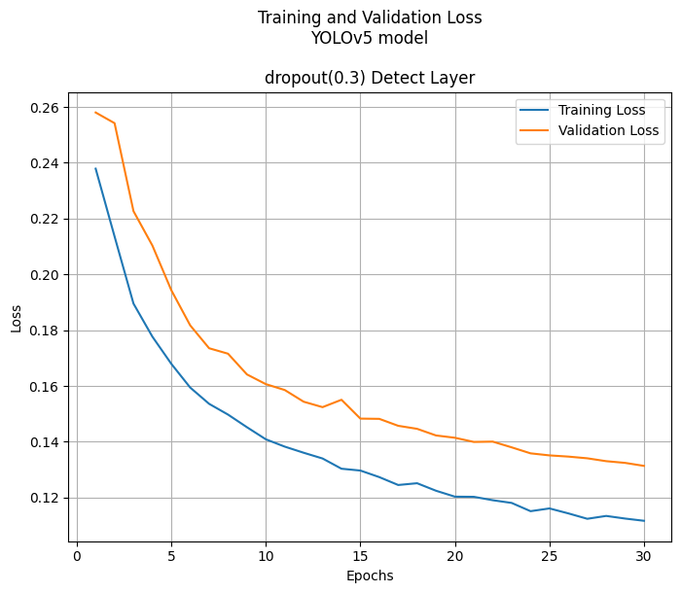
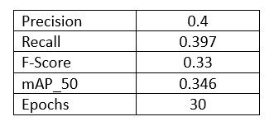
Techniques Used
Dataset Splitting
Dropout
Regularization
Application to Detect Layer
Improvement by 1%

Slide 9
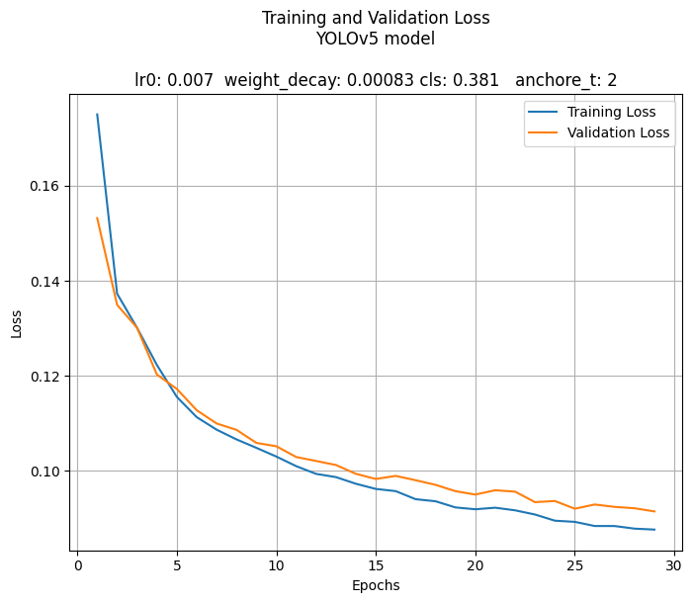
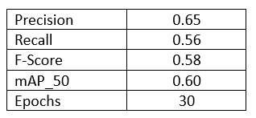
Techniques Used
Hyper Parameter Tuning
It plays crucial role
Learning rates, weight decay and regularization strengths
Up to 50% increase in metrics

Slide 10
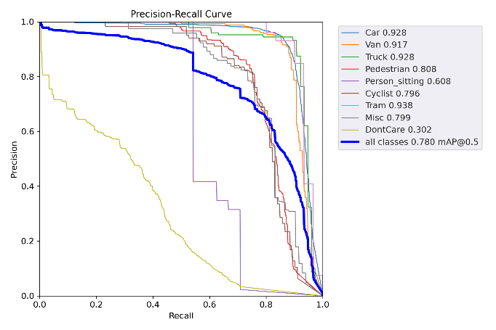
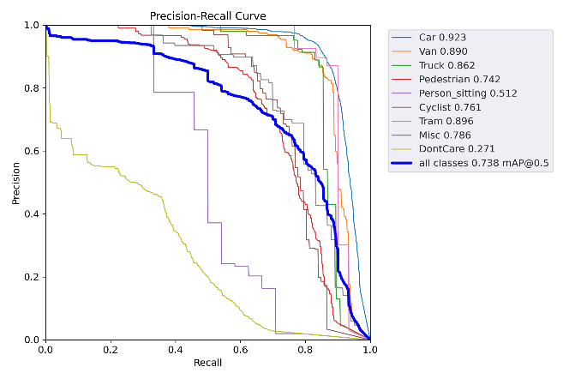
Model Size and Quantization
Real-world deployments and edge devices
Comparison between small and medium model
YOLOv5s YOLOv5m

Slide 11
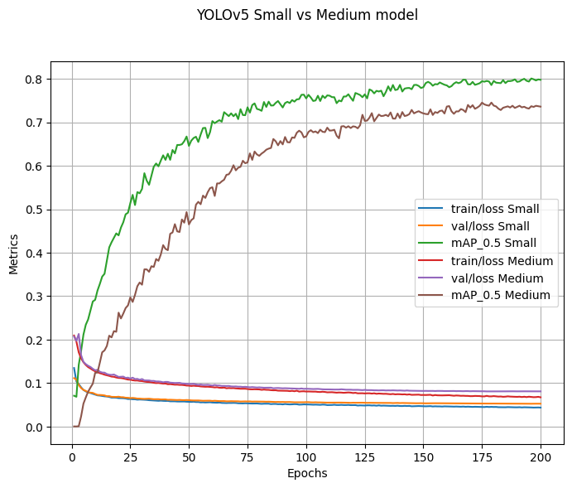
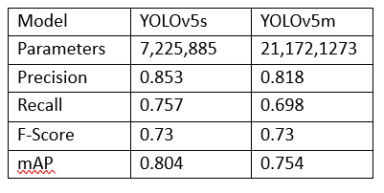
Model Size and Quantization
Comparison between small and medium model

Slide 12
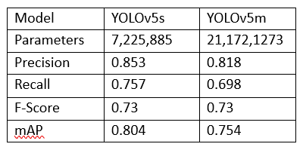
Model Size and Quantization
Post-Training Quantization
32-bit floatin to 8-bit integers

Slide 13
Conclusion
YOLOv5 smaller model performs as well as the medium model
We could generate a compact model for resource-constrained environments without sacrificing significant amount of accuracy

Slide 14
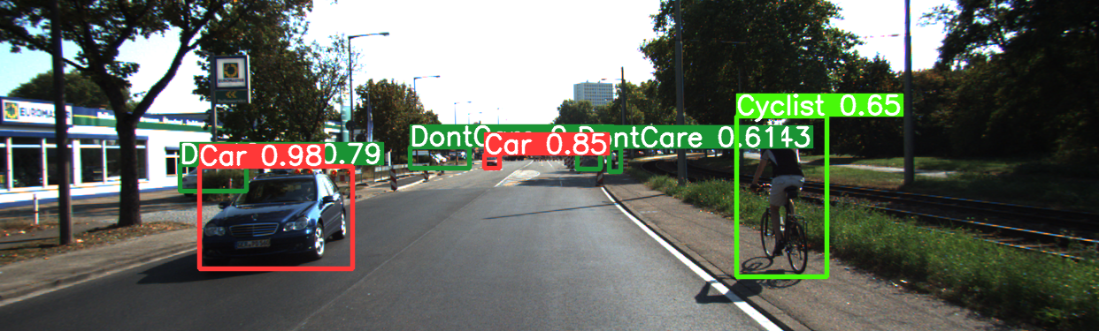
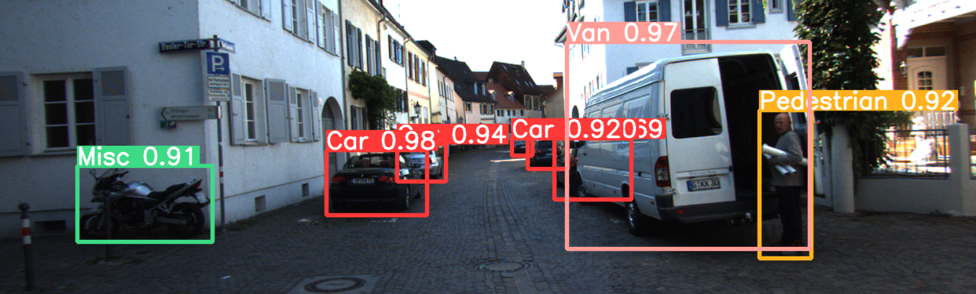
Q&A?

Slide 15
Thank you for your attention

